Slide 1
NORM!
Shannon R. Ruiz – 2014 CCFLT TOY
CY Middle School – Casper, WY
How to prepare yourself and others for grading common assessments
@ShannonRRuiz

Slide 2
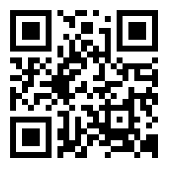
www.shannonruiz.com

Slide 3
Introductions
Who are you?
What do you teach?
Where do you teach?
How much do you love grading assessments?

Slide 4
Integrated Performance Assessment
PERFORMANCE vs PROFICIENCY
INCLUDES:
INTERPRETIVE TASK
INTERPERSONAL TASK
PRESENTATIONAL TASK
BASED ON COMMON THEME

Slide 5
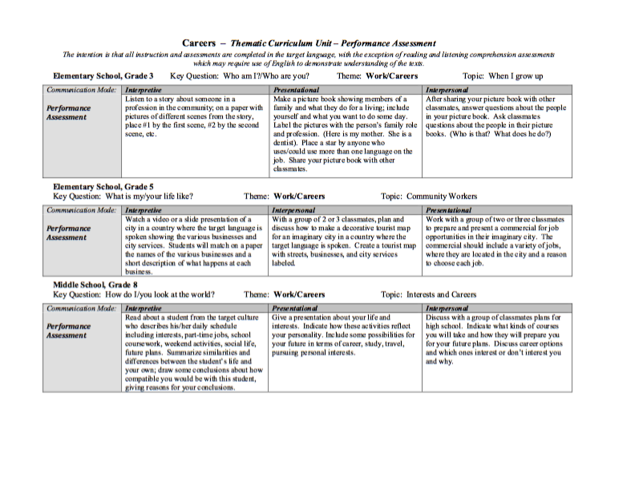
IPA EXAMPLES

Slide 6
Proficiency LEVELS
Novice Level
Intermediate Level
Advanced Level
Novice High vs. Intermediate Low

Slide 7
Rubrics

Slide 8
Grade Norming
Let’s pick a rubric to use today.
Presentational Tasks
Spanish
French
German
Russian
Japanese

Slide 9
Things to remember
Norming begins with using the right assessment
Good idea to create an IPA, then pilot the assessment for a year to get some good student examples to use for norming.
Have a coordinator for the norming process
Must have a solid understanding of Standards, IPA, etc.
Offer multiple opportunities to practice/perfect
Either create a solid core of teachers to serve as graders or get all teachers together to norm at same time.

Slide 10
NORM!
Shannon R. Ruiz – 2014 CCFLT TOY
CY Middle School – Casper, WY
www.shannonruiz.com
How to prepare yourself and others for grading common assessments
@ShannonRRuiz

