Slide 1
GR@MM@R is not a 4-letter word
$&T!!
F%$&!!
Shannon R. Ruiz – 2014 CCFLT TOY
Link to this presentation:
H@%!!
@ShannonRRuiz
www.shannonruiz.com

Slide 2
Who are you and where are you from?
Introduce yourself to two people around you.
They are now your friends.
Link to this presentation:
Found on:
www.shannonruiz.com

Slide 3
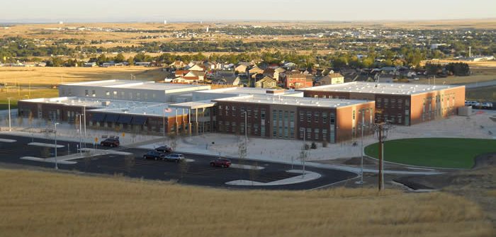
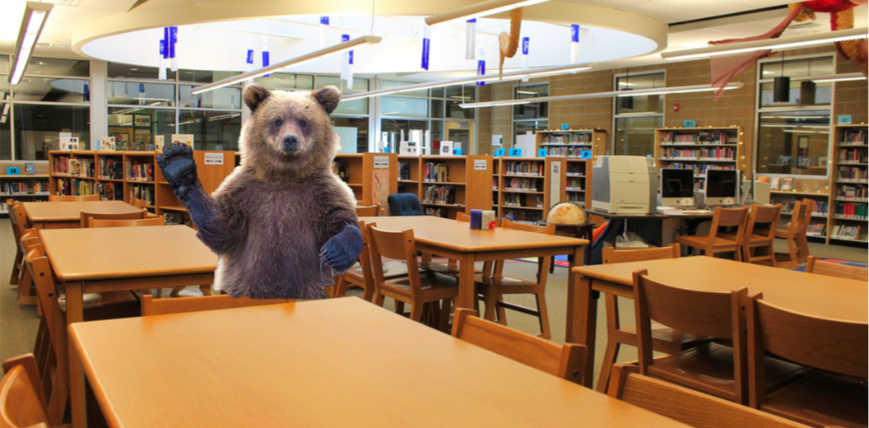
Who is Shannon Ruiz?

Slide 4
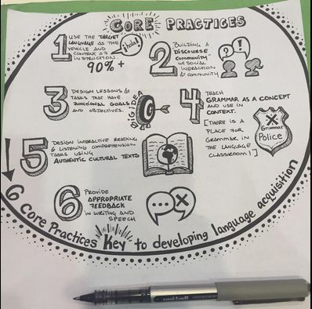
ACTFL Core PRactices
www.cambridge.org/cambridgespanish/blog/
Dorie Perugini

Slide 5
Teach grammar as a concept and use in context
1. Focus on meaning before form
2. There is a place for grammar in the language classroom

Slide 6
Grammar affects comprehensibility
Example:
Today we go to talk when the grammar to be important or when not to use correct the grammar to be acceptable.

Slide 7
Teach grammar as a concept and use in context
Grammar is drawn out of the context
Comprehensible Input:
Readings, songs, etc.
Form is realized afterward.

Slide 8
Teach grammar as a concept and use in context
SO WHAT CAN IT LOOK LIKE?

Slide 9
Teach grammar as a concept and use in context
1. (or 2.) Pick an element to introduce:
El Verbo IR (to go)

Slide 10
Teach grammar as a concept and use in context
2. (or 1.) Pick the context:
¿Adónde Vas? (video)
(senorwooly.com)

Slide 11
Teach grammar as a concept and use in context
3. Student story-guessing:
Using pictures, etc.
Language based on level
THIS IS NOT MOVIE TALK...just wait…

Slide 13
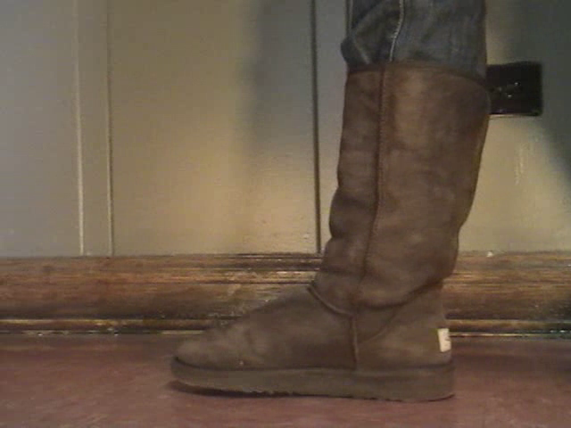

Slide 14
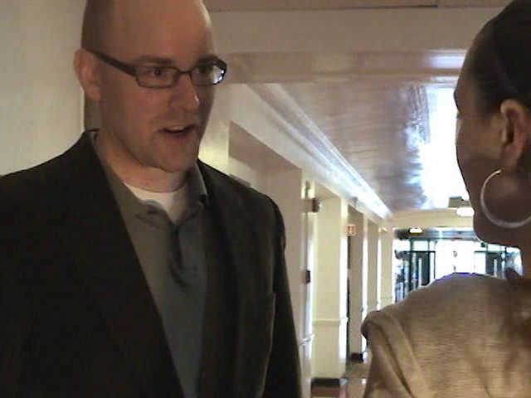

Slide 15
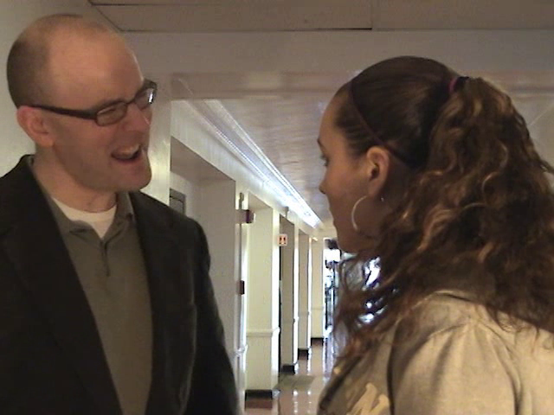

Slide 16
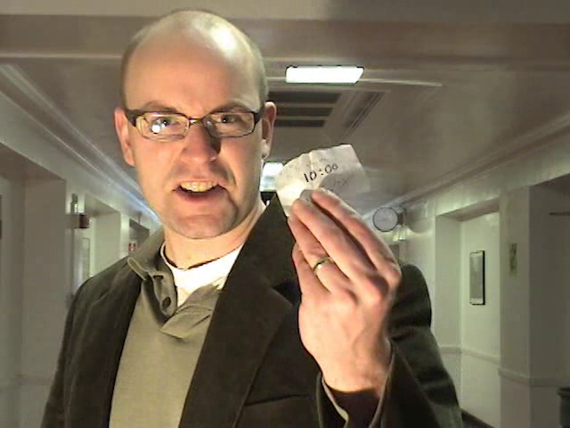

Slide 18
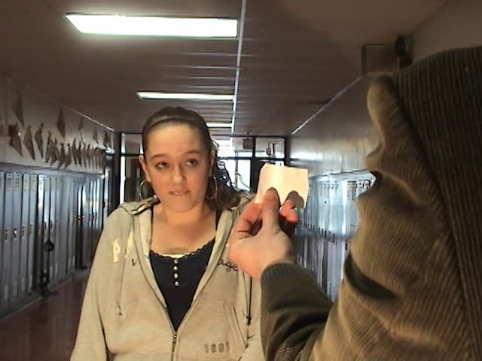

Slide 19
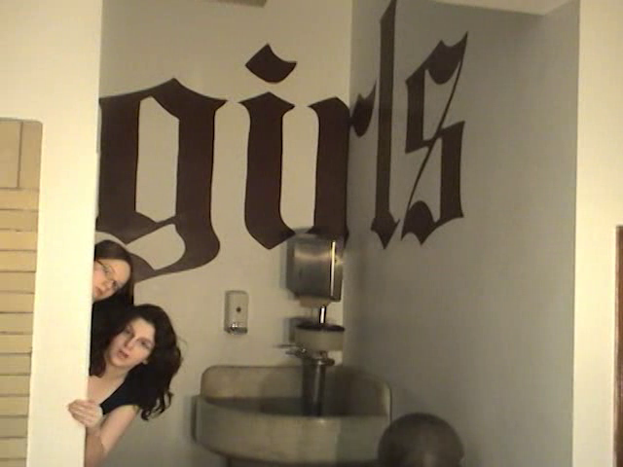

Slide 21
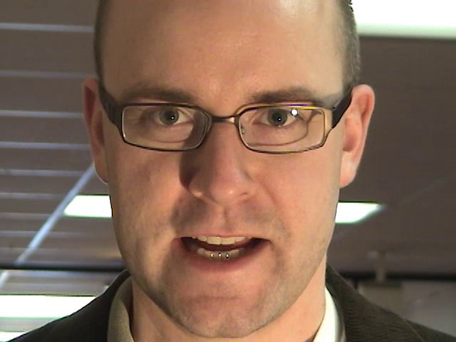

Slide 22
Teach grammar as a concept and use in context
4. Movie Talk:
Using same pictures.

Slide 23
Teach grammar as a concept and use in context
5. Watch Video:
¿Adónde Vas?

Slide 24
Teach grammar as a concept and use in context
6. Ask Questions:
What do you think “¿Adónde vas?” means? What is “vas”?
Then, TL: Where do you go?, etc.

Slide 25
Teach grammar as a concept and use in context
7. Read Lyrics:
Pick out instances of verb ir

Slide 26
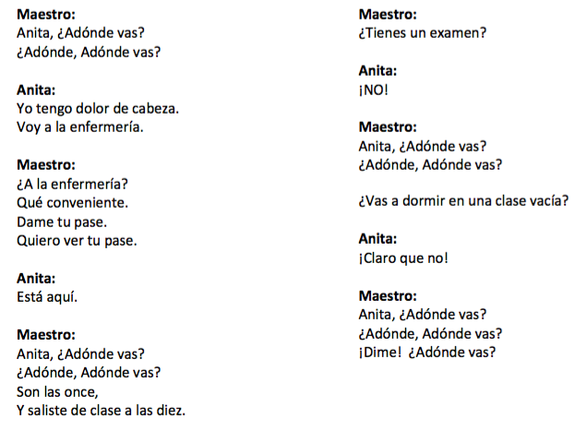

Slide 27
Teach grammar as a concept and use in context
8. Watch Gramática en el 90%:
For the Grammar Nerds out there.
Fill out student notes

Slide 28
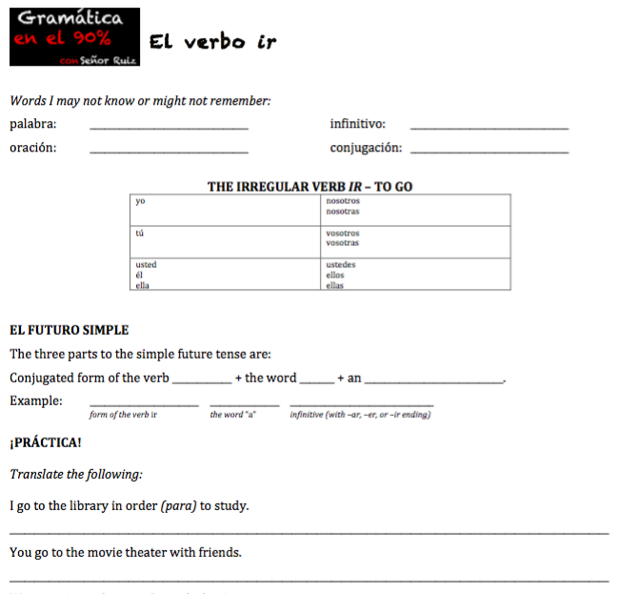

Slide 29
Teach grammar as a concept and use in context
9. Student Storytelling:
In target language –
Presentational Speaking or Writing
Possibly move beyond context

Slide 30
What would you do?
Alternatives?
Exclusions?
Additions?

Slide 31
Looking for Resources?
Spanish:
shannonruiz.com
senorwooly.com
zachary-jones.com
martinabex.com
brycehedstrom.com

Slide 32
Looking for Resources?
German:
learnoutlive.com/german-short-stories-beginners/
French:
www.thefrenchexperiment.com/stories
Japanese:
life.ou.edu/stories/
Chinese:
http://chinesereadingpractice.com/

Slide 33
BONUS Time:
New music video debut!
SER CALVO ES MEJOR
Available at: www.shannonruiz.com
along with supplementary materials.

Slide 34
GR@MM@R is not a 4-letter word
$&T!!
F%$&!!
Shannon R. Ruiz – 2014 CCFLT TOY
Link to this presentation:
H@%!!
@ShannonRRuiz
www.shannonruiz.com

